Slide 1
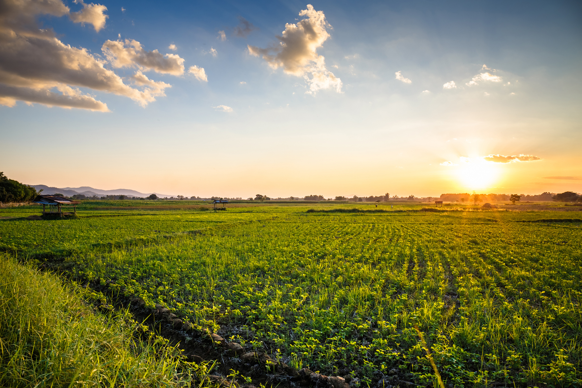


Oct. 27, 2024
5:00 PM LECTURE
Speaker Roger Williams
Current state of farming in Wisconsin
and the Fields of Sinsinawa

